Slide 1
One Dollar, One Hour!!!
Final Project Presentation
Jack Melcher 67574625

Slide 2
I. Problem Statement / Background
Video game databases provide information such as:
Title, Publisher, Developer, Genre, Platform, Rating
As gamer, I would like a know how many hours of playtime I could expect and how does that compare to a game’s price.

Slide 3

II. Idea Origins
Sean Poole (aka Spoole)
Youtube
Formerly worked for the channel FunHaus
Twitch Streamer
https://www.twitch.tv/spooleo
One Dollar, One Hour: A video game’s playtime should be at minimum be equivalent to its price.
Ex: A $60 game = 60 hours of playtime
https://www.youtube.com/watch?v=NwICCNGMpa4

Slide 4
III. Solution
Obtain data from a website that uses Steam Web API
Have access to a large library of video games
Price
User data on playtime
Perform calculations to determine whether a videogame is “one dollar, one hour”.

Slide 5
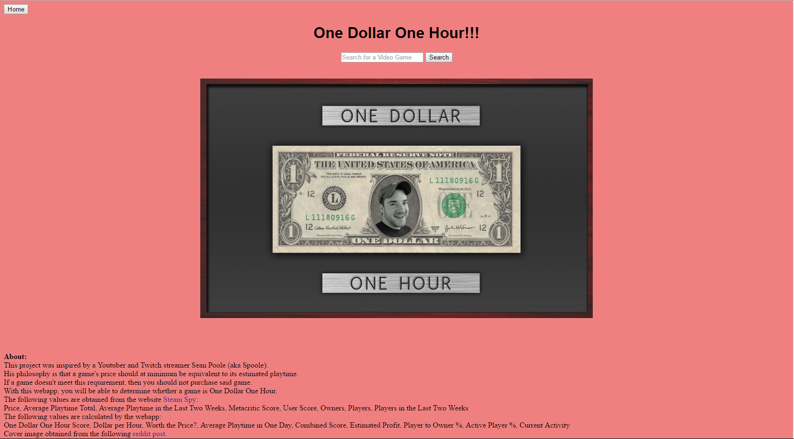
IV. Demo
http://128.195.204.85:8081/JackMelcher/index.jsp

Slide 6
V. Future Work
Obtain and use Steam Web API
Provide more accurate estimations on:
playtime hours, game profit, and a range of hours players have spent playing the game.
Expand so webapp works for videogames on other platforms, such as home consoles
Create a modern and clean design for the website.

